Slide 1
Photonic measurement of gas pressure.
Arbeitsgruppe 7.55
André Kussicke

Slide 2
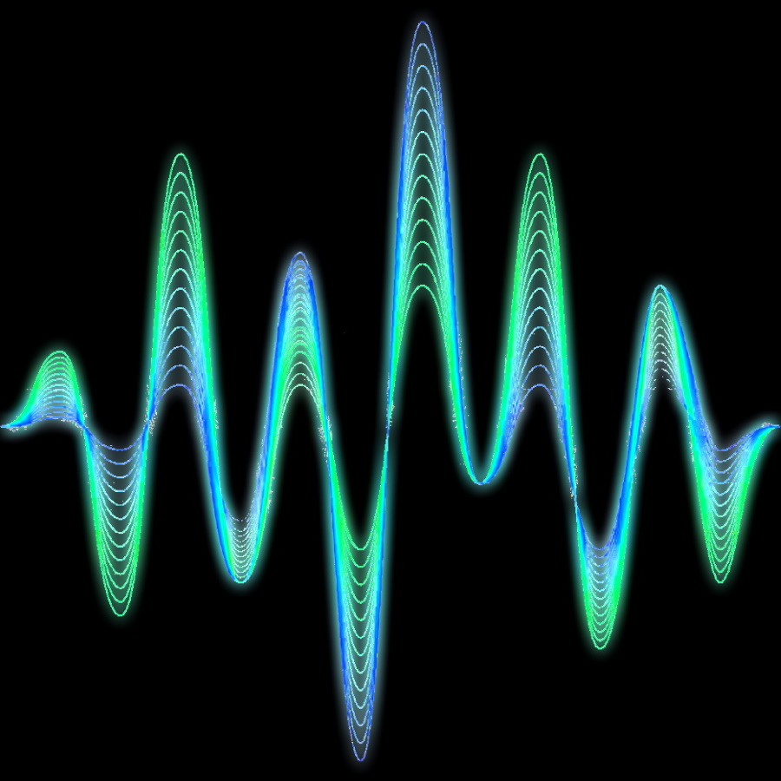
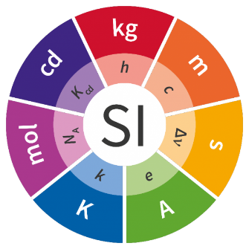
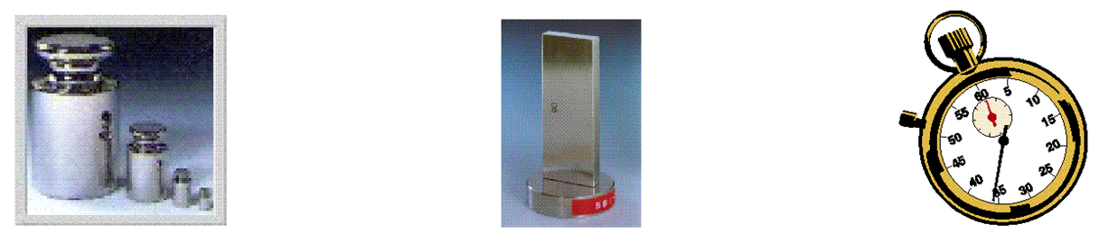
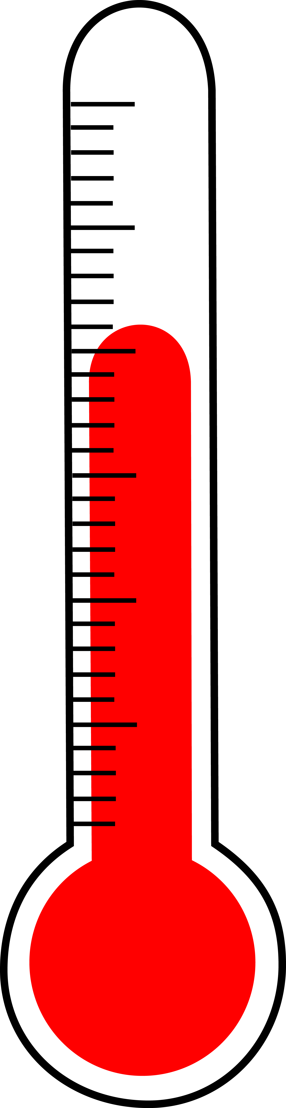
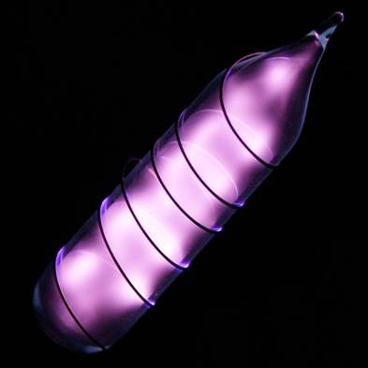
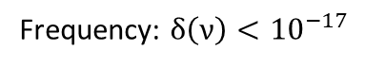
Motivation of the Quantum Pascal Project
Usefull in vacuum
Frequency: $δ\left(ν\right)<{10}^{−17}$
New SI: u(k) = 0
Status Quo:
Force per area
Methods based on density measurements
Helium
New theory
u(n_{He}−1) < 10⁻⁶
kg
m
s
K
m
s

Slide 3
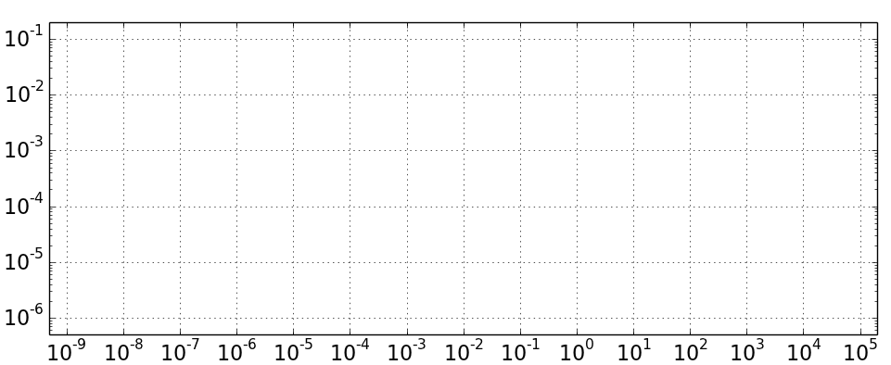
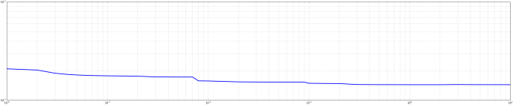
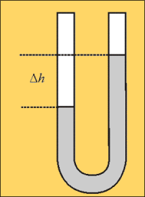
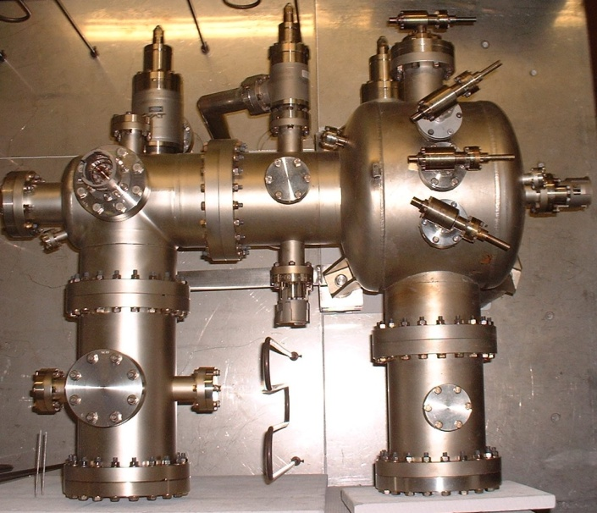
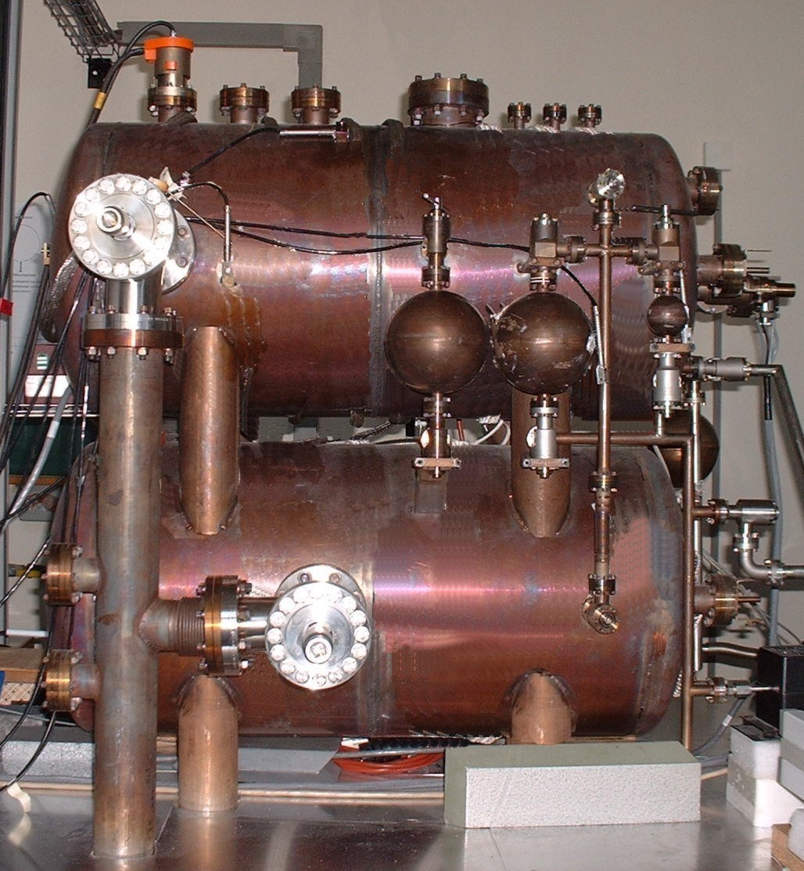
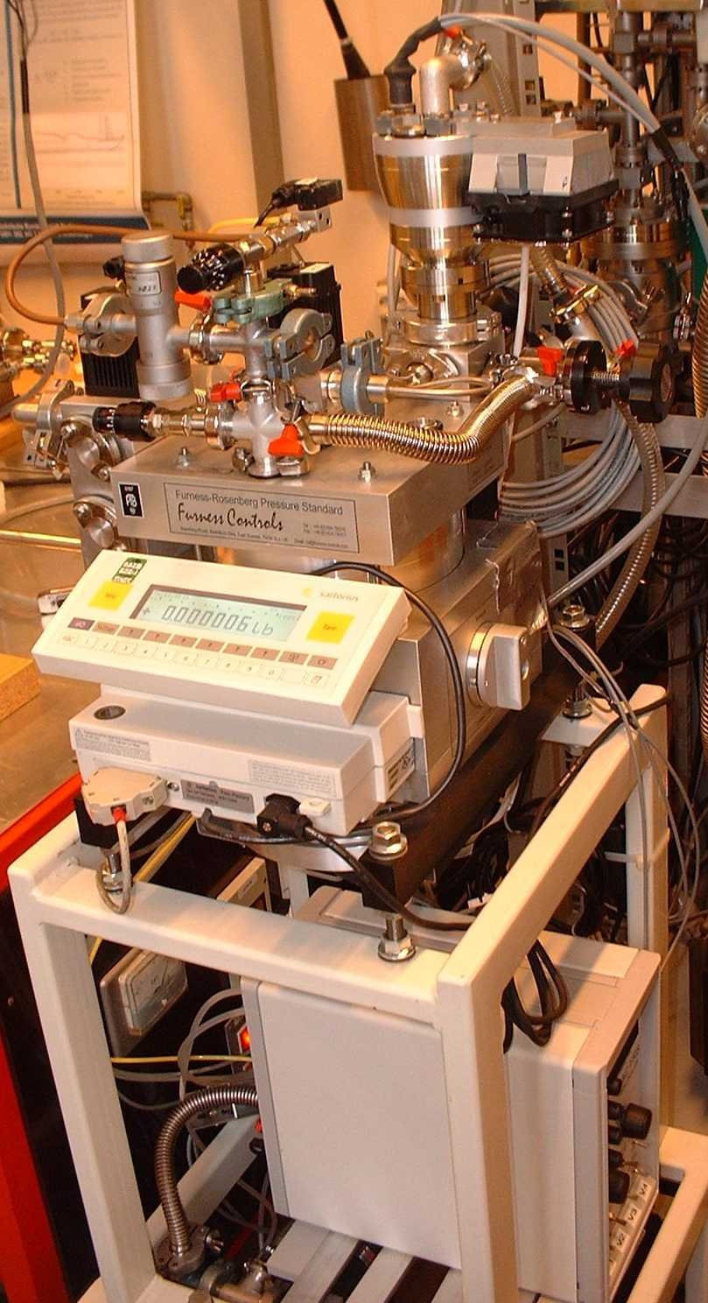
Quantum Pascal Project: Goals
Status Quo – Established methods
AG 7.54 – Vacuum Metrology
AG 3.33
Hg-Manometer
Schwien (BS)
Continious Expansion
Static Expansion
Relative uncertainties
Pressure-
gauge
Pressure (Pa)
Design new optical pressure standards.

Slide 4
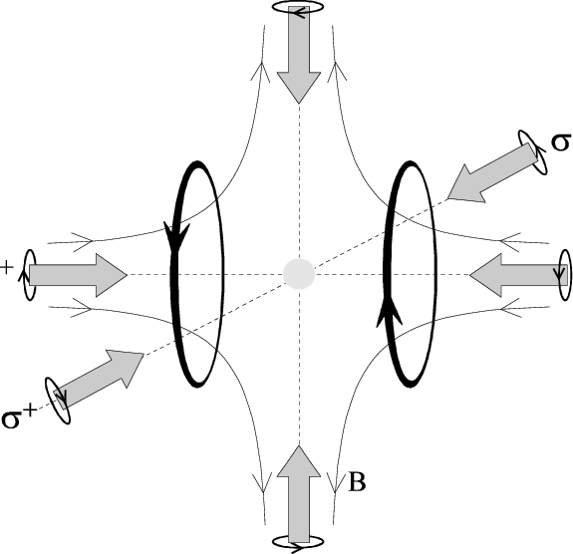
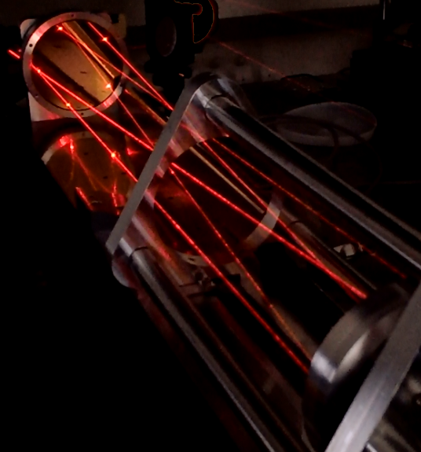
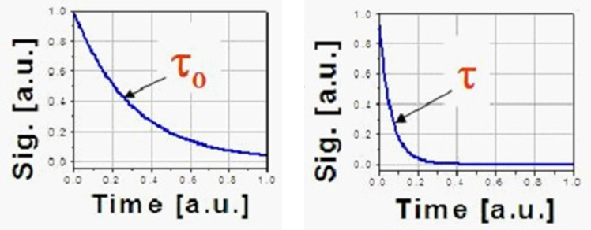
New photonic methods
AG 7.54 – Vacuum Metrology
AG 3.33
Continious Expansion
Static Expansion
Pressure balance
relative uncertainties
Hg-Manometer
Schwien (BS)
Magneto-
optic
traps
Absorption-spectroscopy
with Herriott-Cells (CO₂)
Cavity-Ring-Down-
Spectroscopy (CO₂)
Refractivity measurements
(He, Ar & N₂)
Pressure (Pa)

Slide 5
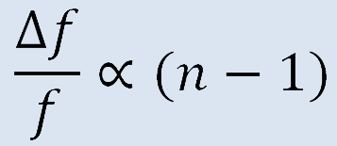
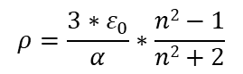
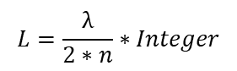
Measurement principle
Lock-In-Technique feedback loop
T
Thermostatisation
Double-resonator
Laser 1
Lock-In-technique and
frequency measurement
Laser 2
Pure gases
$$L=\frac{λ}{2∗n}∗Integer$$
Differential pressure measurement
Gases: He, Ne, Ar
Fabry-Perot-Resonator
Measurement of the refractivity by using the frequency difference.
Calculation of the partial pressure using the ideal or real gas law.
$$ρ=\frac{3∗ε_{0}}{α}∗\frac{n2−1}{n2+2}$$
p$=ρ∗k_{B}∗T∗\left(1+B(T)∗ρ+C(T)∗ρ2+...\right)$

Slide 6
Measurement principle
Lock-In-Technique feedback loop
T
Thermostatisation
Double-resonator
Laser 1
Lock-In-technique and
frequency measurement
Laser 2
Pure gases
$$L=\frac{λ}{2∗n}∗Integer$$
Differential pressure measurement
Gases: He, Ne, Ar
$$ρ=\frac{3∗ε_{0}}{α}∗\frac{n2−1}{n2+2}$$
Temperature
u(T) < 300 μK
Gas purity
7.0
p$=ρ∗k_{B}∗T∗\left(1+B(T)∗ρ+C(T)∗ρ2+...\right)$
Length
u(L) < 3*10⁻¹¹ m
Frequency
u(f) < 15 kHz

Slide 7
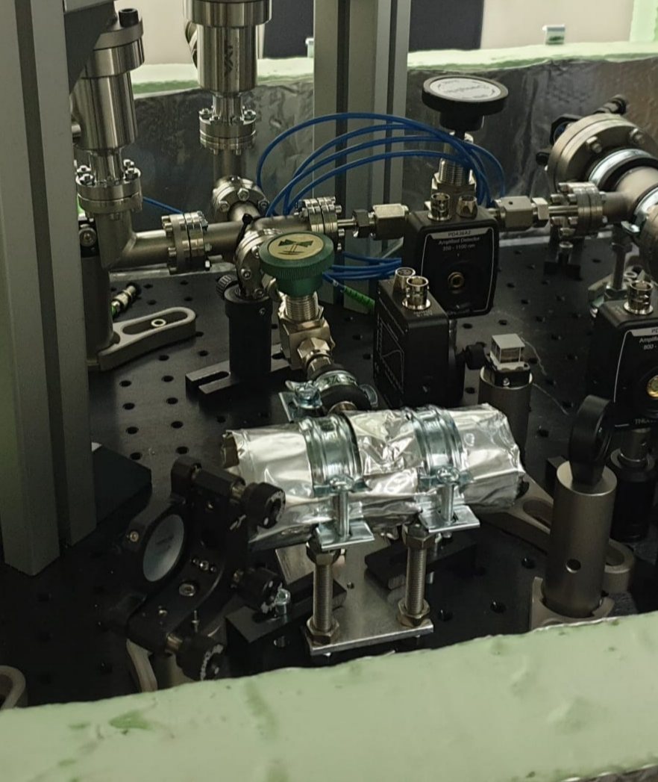
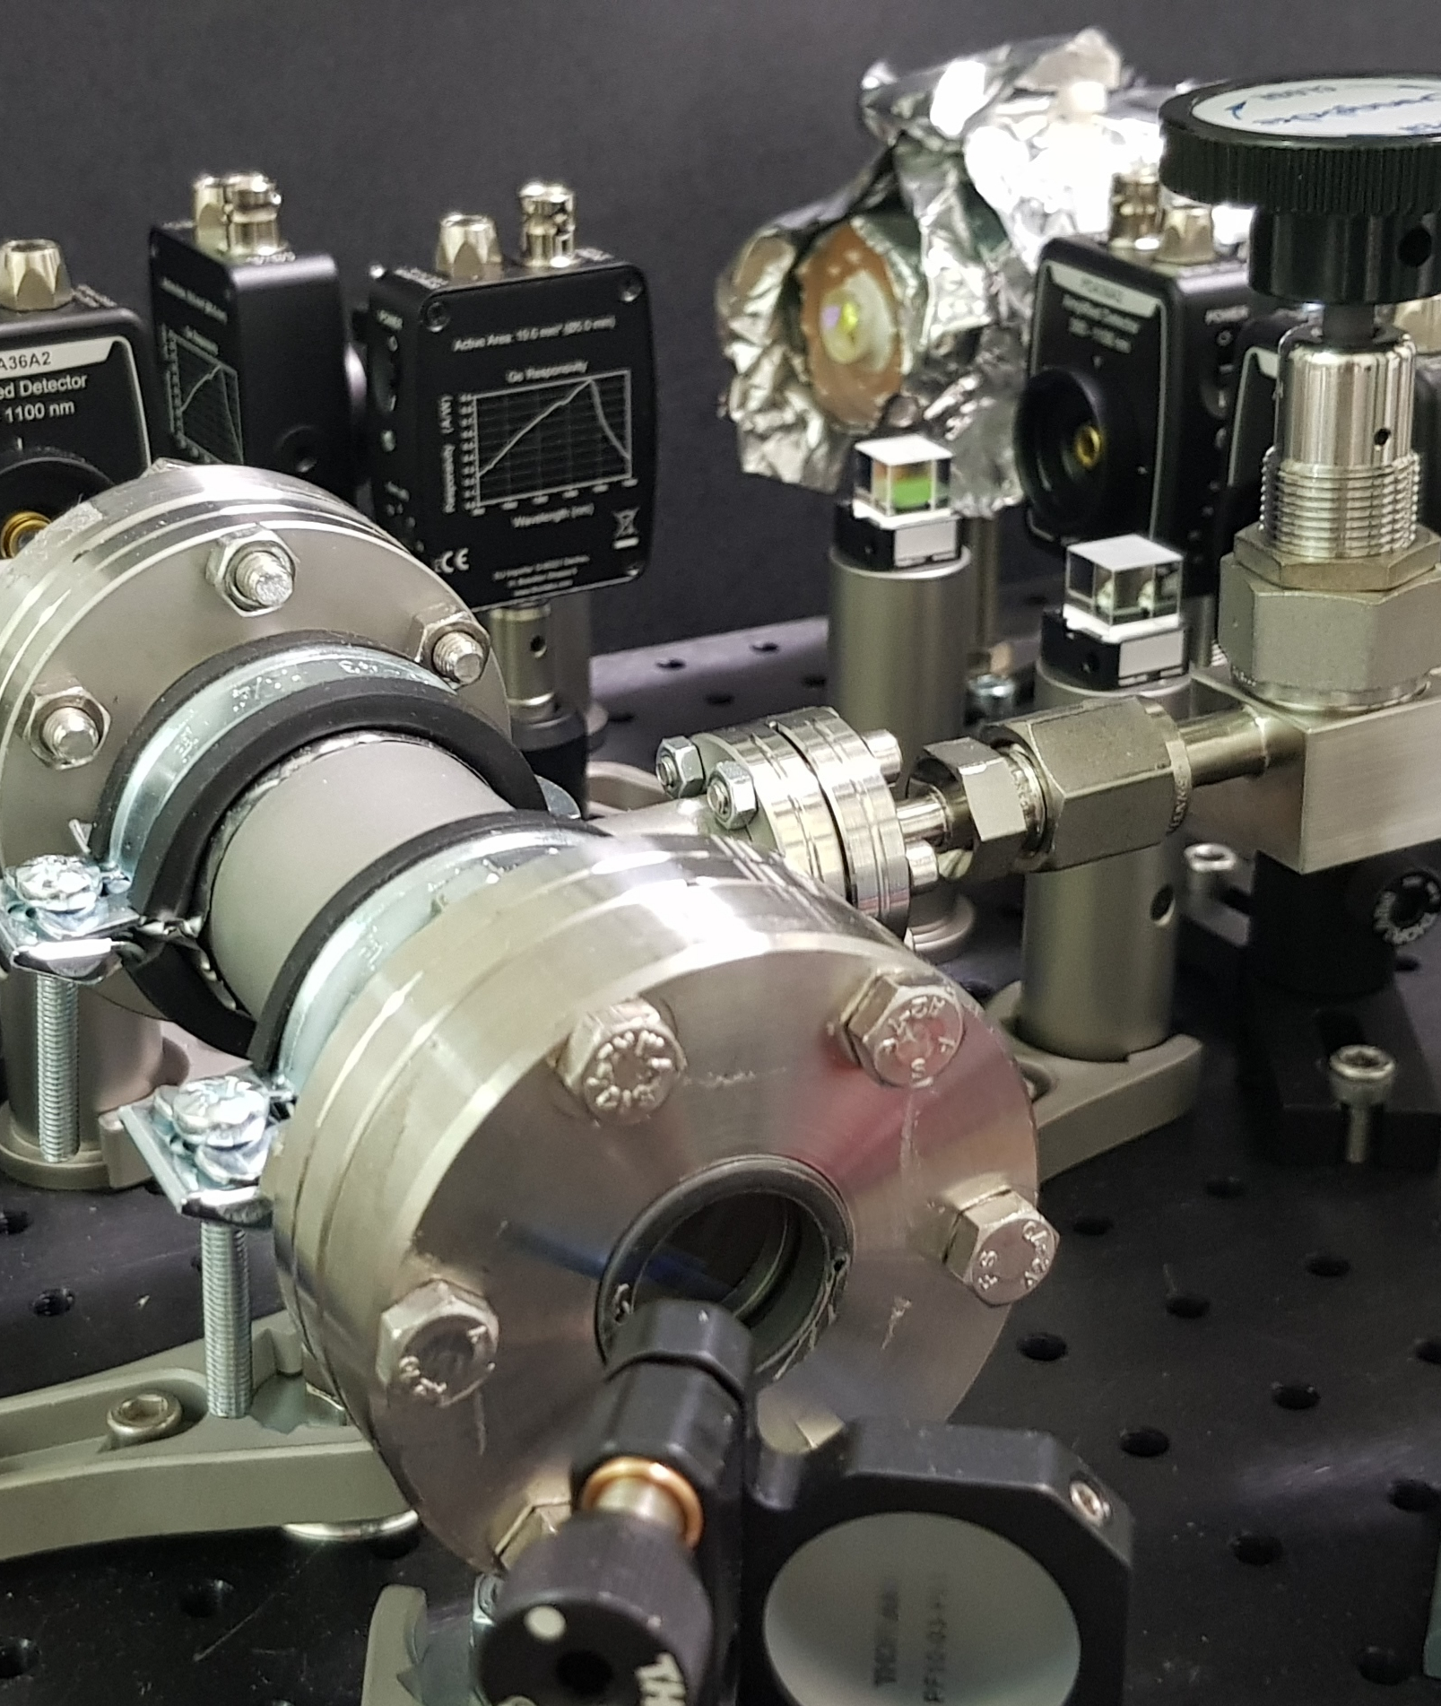
New refractometer at the PTB

Slide 8
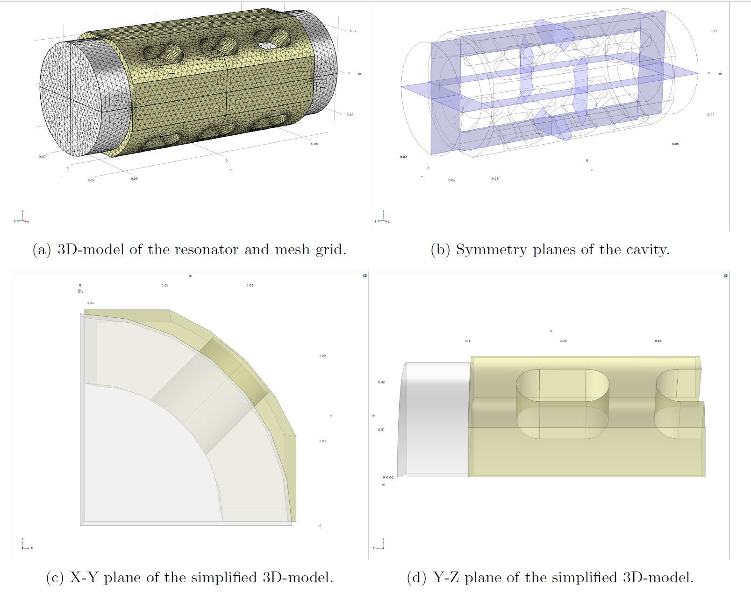
Pressure induced deformation

Slide 9
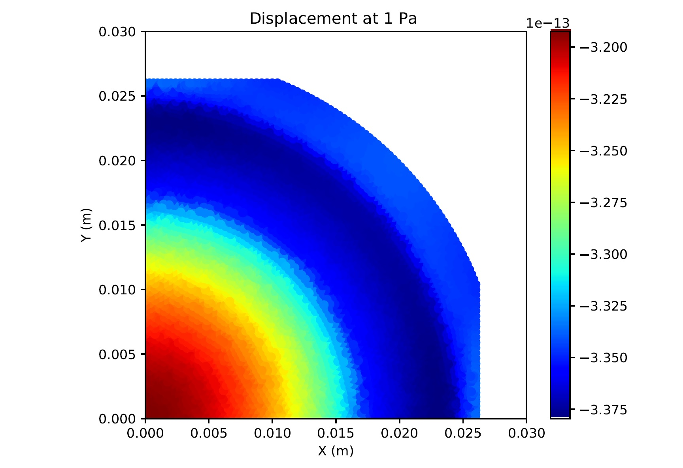
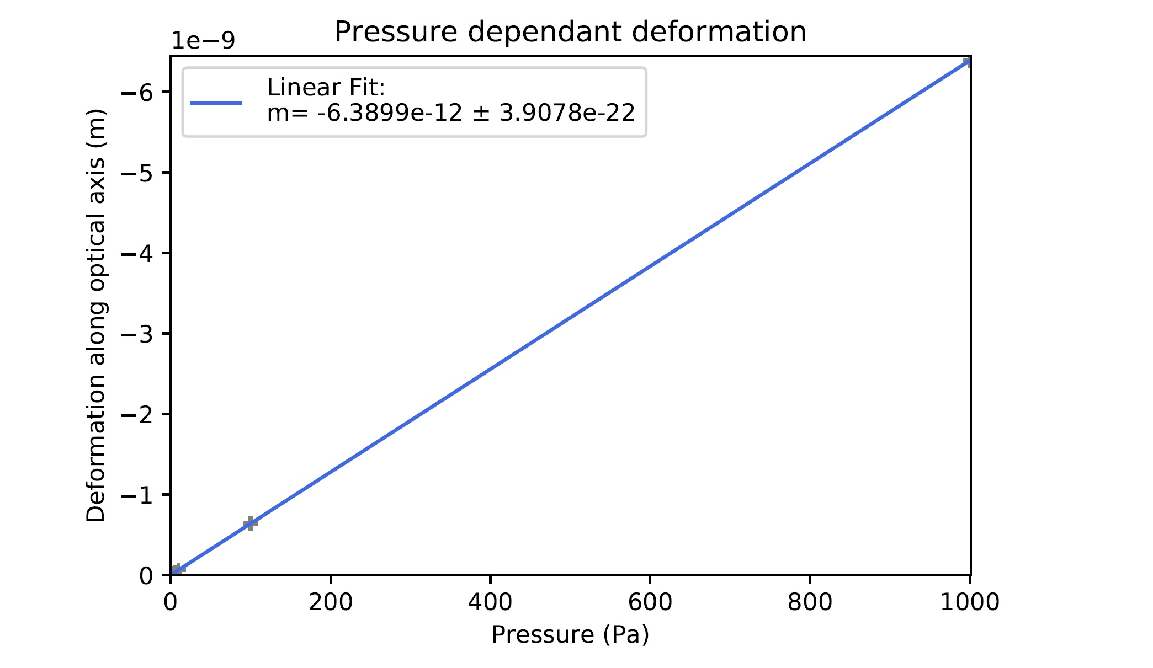
Pressure induced deformation
Pressure induced cavity length change: 6.389 pm per Pa

Slide 10
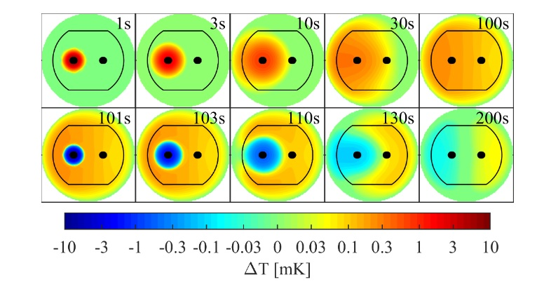
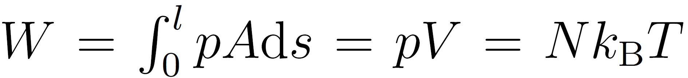
Thermodynamic effects
pV work heats up the gas and cavity walls.
The temperature change (ΔT) is maximal at 5mK (for t=1s).
After 40s ΔT is less than 0.5mK and does not negatively influence measurements.

Slide 11
Frequenzy stabilisation
L3 Stabilized HeNe-Laser
Frequency-Counter
L-2
Beat Detector
Spectrum Analysator
Lock-in-control
L2 Tuneable diode Laser
L-2
L-2
Resonator
Detector
L1 Tuneable diode Laser
L-2
Resonator
Detector
Lock-in-control
Frequency-Counter
Fast Detector
Opto-elektronic frequency stabilisation:
Lock-in-technique
Comparison with stabilized HeNe-Laser
Pound-Drever-Hall-stabilisation
Spectrum Analysator

Slide 12
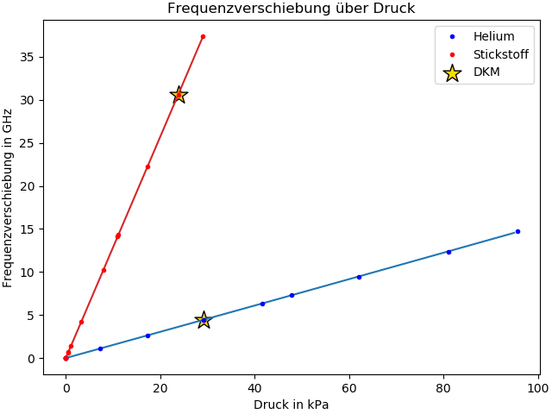
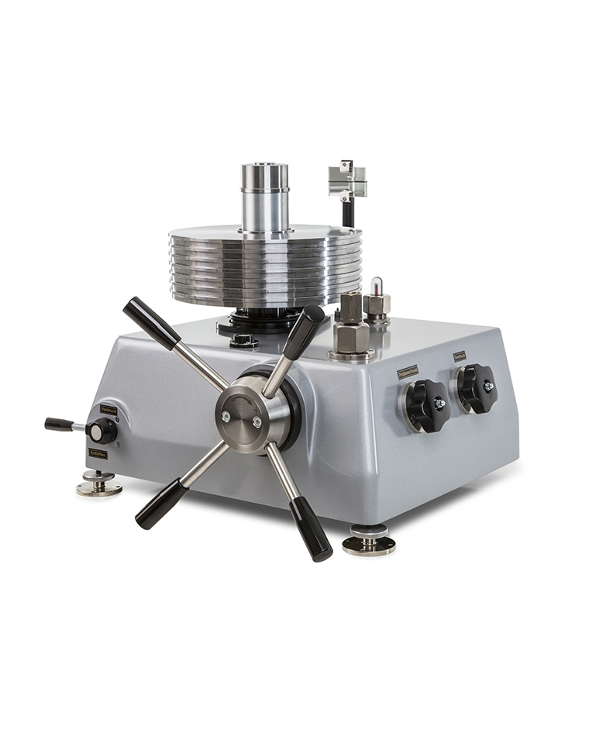
Uncertainty of refractivity measurements
Frequency shift over pressure
Pressure measured with RSG‘s
Laser frequency shift obtained from beat measurement with reference resonator.
Comparison with pressure generated by pressure balance (DKM) at 30 kPa.
Δ(n-1)_{He} = 3.8*10e-4
Frequency shift in GHz
Pressure in kPa
„DKM“ (Pressure balance)

Slide 13
Physikalisch-Technische Bundesanstalt
Braunschweig und Berlin
Abbe Straße 2-12
10587 Berlin
André Kussicke
E-Mail: Andre.Kussicke@PTB.de
www.ptb.de

Slide 14
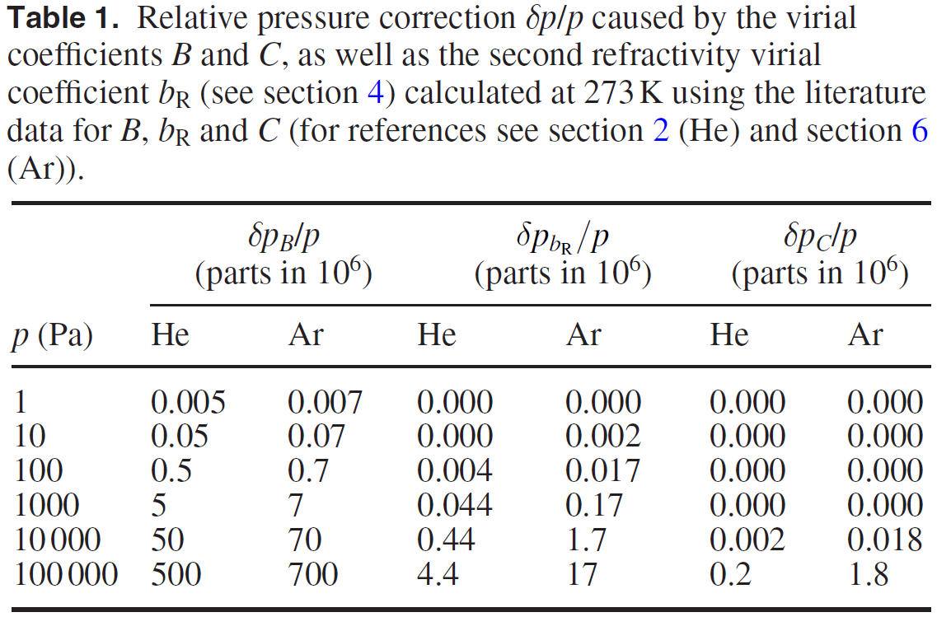
Virialkoeffizienten
Karl Jousten, et al. Perspectives for a new realization of the pascal by optical methods. Metrologia 54 S146 (2017)

